Slide 1
Building country specific Omnichannel HCP Journeys to support launch
March 2021

Slide 2

Why build HCP Journeys?
HCP journey mapping is important, because it helps us
to drive Jyseleca adoption by planning and delivering strategic HCP engagements, based on customer needs.
HCP journey mapping allows us to create first step into personalised experiences across all touchpoints, leveraging our content, data, technology and channels.

Slide 3





Journey Mapping enables the visualisation of a target HCP experience
Uncover behavioral segments by analyzing HCP data across touchpoints over time
Measure the impact of HCP behavior on KPIs
A deeper understanding of HCP needs, behaviors, emotions as they seek to achieve a goal
A journey dashboard to bring together qualitative and quantitative data to highlight factors with greatest impact on goal achievement
Journey discovery
Project Scope
01
Ideate and communicate journeys for Jyseleca to become more HCP centric
Create a visualization of your HCP experience across touchpoints over time, including actions and emotions as they seek to treat their RA/IBD patients
02
Journey Insights
Journey Mapping
HCP Journey capabilities
HCP Journey Capabilities
t
05
03
Increase the rate and speed at which HCPs complete their own unique and semi-personalized journey to reach an objective
Create and use a platform to create and test hypothesis to learn how to interact most efficiently with each HCP based on their unique journey
Journey Orchestration
Journey Optimization
04
Coordinate interactions across channels, automate interactions (where possible and relevant) at each step of journey
Personalize engagement using information about HCP and where they are in the journey
Build a platform that automates real time personalized interactions to improve journey flow and drive desirable outcomes for HCPs and patients

Slide 4
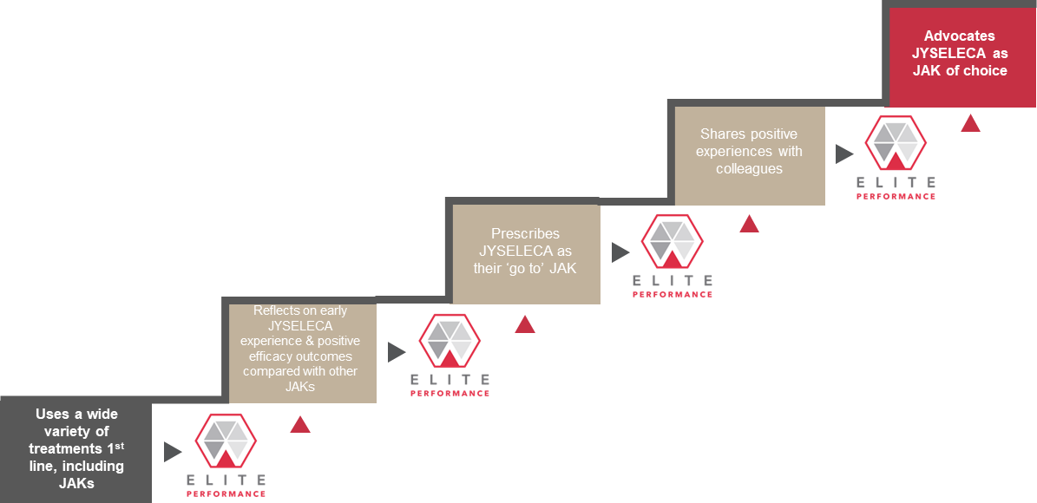
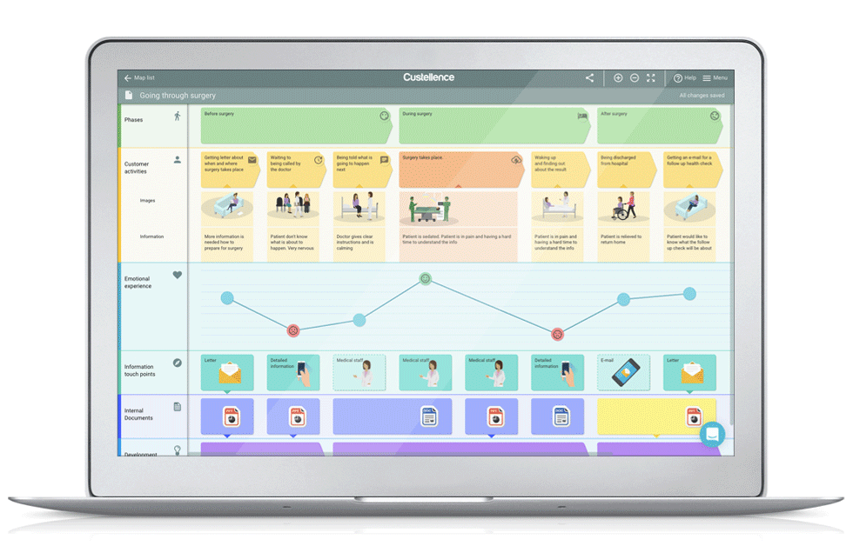
Adoption Ladder
HCP Journeys
The HCP-focused mapping of the level of product adoption.
The execution-focused mapping of the touchpoints with a HCP.

Slide 5

What will I get at the end?
A clear, 12-month* Customer Journey for your market and indication (RA/IBD)**, linked to driving HCPs up the initial stages in the adoption ladder
Journeys that are linked to content both existing and currently in production for launch, with easy access to the materials needed for execution (and view on planned content)
An easy-to-use Customer Journey format, to enable dynamic updates throughout the year
*length is an estimate, journeys will likely be more focused around adoption stage TBD during week 1
**See project plan for market and indication delivery details

Slide 6



CURRENT
DESIRED
Behaviour Change
Uses a very broad spectrum of products including JAKs
Uses very recently launched products
Able to talk extensively about new and pipeline treatments
Willing to act ahead of guidelines
Tries JYSELECA with some patients
(After they have gained experience) Expand JYSELECA use in a wider range of patients in preference to other JAKs
Unmet Need
Research
1st Rx
Prescribes
Advocates
Adoption Stage
Uses a wide variety of treatments 1st line, including JAKs
Reflects on early JYSELECA experience & positive efficacy outcomes compared with other JAKs
Prescribes JYSELECA as their ‘go to’ JAK
Shares positive experiences with colleagues
Advocates JYSELECA as JAK of choice
.
Galapagos Goal
.
Barriers
Messages
Message Source
Be clear to markets that this is the starting point –with local segmentation preference applied, show why we’re focusing one segment, show research
ERN: Mavericks – early adopters, sensible to focus first.
Pragmatists - often early adopters too, don’t ignore (let me try it)
Two different approaches needed.

Slide 7
The international team would like to support you in developing omnichannel customer journeys
We are starting a rapid, focused project to co-create pragmatic, executable, local Customer Journeys that will help drive superior HCP experiences
International Journeys delivered by mid-April
Detailed market Journeys to be delivered between April → May*
*Country-specific - See project plan for detailed schedule

Slide 8

The Principles
We want to ensure these journeys are actionable for your market, so we have three core principles
Simple
The Journeys will be as simple as possible, and not overcomplicated to ensure easy execution (e.g. applicable in your daily work)
Practical
The Journeys will be connected to existing and future content, and aligned to key events
Local
After creating an international version, we will work with you to localise the journeys to meet your market need

Slide 9


What is in it for me?
By working with the project team, there are several benefits to you
Targeted support to create Customer Journeys during a very important launch period
An industry best practice framework and approach for creating tangible journeys
The opportunity to ensure the journeys are tailored to your market for easy execution
The opportunity to use marketing expertise from other markets

Slide 10

Your support throughout this process is essential to ensure the journeys we create together help drive your local campaign execution

Slide 11
The project plan detail of Phase 1
March |  |  | April | April |  |  | May | May
15 | 22st (1) | 29th (2) | 5th (3) | 12th (4) | 19th (5) | 26th (6) | 3rd (7) | 10th (8) | 17th (9) | 24th (10)
Phase 1a
Customer Journey Foundations
Phase 1b
Build & Test international RA/IBD Customer Journey
Phase 1c
Detailed localization of RA/IBD Customer Journeys for large countries
Phase 1d
Localisation for smaller markets
Team
Core project team
Core Team + International project team
Core Team
+
International project team +
2 Market Representatives
France
(RA)
UK (RA&IBD)
NL
Germany (RA&IBD)
BelLux
Spain (RA)
Italy (RA)
Format
Working sessions
4 x 2-hour sessions
Working sessions
IBD → 2 x 2-hour sessions
RA → 2 x 2-hour sessions
We will be facilitating multiple workshops within your countries
to support the development of your local CJ
Large countries: 3x two-hour workshops,
Small countries: 2x two-hour workshops,
Journey Templates & Framework
Draft Adoption Pathways & Customer Journeys
Populated International Adoption Journey + International Customer Journeys
Local Adoption Journeys & Customer Journeys
+
Training & eLearning module
Outputs

Slide 12
Engagement with a FR/UK/DE/ES/IT
Workshop 1
Workshop 2
Workshop 3
2hrs
2hrs
2hrs
Who: (proposed)
The core team + Local team
Local team to include the required stakeholders to ensure accurate Journey development (Marketing / Medical / Sales)
Input:
International Adoption ladder
International Customer Journey
Local events calendar and content plans and prior work
Activity:
Working session to localise the global adoption ladder, and to localise the international HCP journey against key market events, channels and goals
Output:
Adoption Journey finalised
Draft of local HCP journey created leveraging potential existing work
Who: (proposed)
The core team + Local team
Local team to include the required stakeholders to ensure accurate Journey development (Marketing / Medical / Sales)
Input:
Local adoption ladder
Iteration #1 on HCP Journey
Activity:
Working session to iterate the local HCP journeys
Output:
Updated version of the local HCP journey
Who: (proposed)
The core team + Local team
Local team to include the required stakeholders to ensure accurate Journey development (Marketing / Medical / Sales)
Input:
Local adoption ladder
Iteration #2 HCP Journey
Activity:
Working session to finalise the local HCP journeys
Output:
Final version of the local HCP journey
For UK & Germany, where both RA & IBD journeys are being created, the workshops will be run in parallel in separate groups for each indication, with the outputs being entirely specific.

Slide 13
Engagement with a NL/BNL
Week 1
Week 2
Workshop 1
Workshop 2
2hrs
2hrs
Who: (proposed)
The core team + Local team
Local team to include the required stakeholders to ensure accurate Journey development (Marketing / Medical / Sales)
Input:
International adoption ladder
International HCP journey
Local events calendar and content plans
Journeys produced in 2020
Activity:
Working session to localise the global adoption ladder, and localising the international HCP journey against key market events, channels and goals
Output:
Adoption Journey finalised
Updated local HCP journey created
Who: (proposed)
The core team + Local team
Local team to include the required stakeholders to ensure accurate Journey development (Marketing / Medical / Sales)
Input:
Local adoption ladder
Workshop 2 HCP journey
Activity:
Working session to finalise the local HCP journeys
Output:
Final version of the local HCP journey

Slide 14
Project Phases
March |  |  | April | April |  |  | May | May
15 | 22st (1) | 29th (2) | 5th (3) | 12th (4) | 19th (5) | 26th (6) | 3rd (7) | 10th (8) | 17th (9) | 24th (10)
Project Management
Create Customer journey maps
1
Phase 1b
Build & Test Regional HJ Maps
Phase 1c
Detailed Localization of HJ Maps for France, Germany, UK, Spain, Italy
Phase 1d
Finalized Localization of HJ for NL and BelLux
Phase 1a
Foundations for HCP J Maps
Align maps with CRM/CDP
2
Phase 2a
Define Alignment between CJ Maps & CRM/CDP
Phase 2b
Build action plan to operationalize alignment
Mobilization
Build HCP journey map understanding
3
Phase 3a
Build Tactic Plan
Phase 3b
Build e-learning module
Phase 3c
Train the Trainer (CJ Market Champions)

Slide 15



An experienced Veeva team will helps us achieve our goals and will be supporting you
CORE DELIVERY TEAM
SME
Louisa Peacock
Veeva Lead
Alexandre Raynaud
CJ Architect
Gareth Allot
Engagement Manager
Alex Richwood
Business Consultant
Aaron Bean
VP, Business Consulting Lead
Europe BC Head
Brings deep LS Expertise and 8+ years defining Commercial Strategy and Operating Models
Louisa has worked with large enterprise Pharma in defining and executing on Commercial and Medical models including omni-channel orchestration and go to market engagement models.
Prior to joining Veeva she worked at EY and Accenture consulting where she worked in the US and Europe on complex multi geography / functional LS teams. Clients include Astellas, AZ, BMS, Takeda, Merck.
Brings expertise in designing Customer journeys with Galapagos France
Alexandre Leads Veeva's Business Consulting Practice in France and specialises in commercial excellence, innovation and digital transformation.
He brings 15 years' experience in marketing and sales functions both at affiliate and global level, working across the drug lifecycle and 7 therapeutic areas, including at Lilly.
Brings extensive experience designing and operationalizing Commercial Models
Gareth has deep experience in the execution of omni-channel and leads on engagements across Europe in Field Force optimization and Veeva Pulse. being passionate about providing data driven insights.
Prior to joining Veeva Gareth worked in Accenture consulting’s HLS practice, leading multi market global commercial programs
Brings Field Force sizing, modelling and analytic capability
Alex has joined Veeva having recently completed an MBA at HEC Paris.
He has supported projects in sales force efficiency and optimization, providing market research, data and analytics.
Alex joined Veeva to help define and enable the new model for the future in LS.
Aaron leads Veeva's European Business Consulting Practice and specializes in commercial excellence, innovation and digital transformation. enabling clients to design and deliver world class customer experiences
He brings over 18+ years' experience, prior to Veeva, Aaron was the Life Sciences Advisory Lead in EY UK.

Slide 16
2 key journeys to be defined, with the adoption journey underpinning the target customer journey
Customer ’Execution’ Journey
Adoption Ladder

